Slide 1
SMART PURSE FOR WOMEN

Slide 2
MODULES:
Hardware module: NodeMCU,BLE,Battery etc.
Sanitary napkin compartment
Geolocation module
Android App
Machine learning module

Slide 3
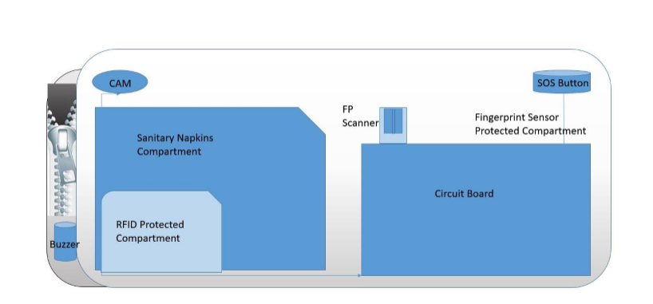
PURSE MODEL:

Slide 4
APPLICATIONS
PUSH BUTTON-1
To activate SOS alarm
To deactivate SOS alarm
To notify trusted contacts (if pushed for 3-4 seconds)
PUSH BUTTON-2
To find a phone if BLE is in range
To stop distance alarm
BUZZER:
For SOS alarm when pushbutton-1 is pushed for 2 seconds
For Distance alarm when BLE goes out of range
For finding a purse with pressing a button on the app when BLE is in range

Slide 5
BLE
For distance alarm
For communicating with smart phone
BATTERY
Can be used as a power bank for smart phone
NodeMCU
When BLE goes out of range for long time it will find location of purse using geolocation whenever open WIFI is available near purse

Slide 6
FUTURE SCOPE:
FINGERPRINT SENSOR
To secure purse biometrically
GPRS MODULE WITH NODEMCU
To know location of purse countrywide
RFID PROTECTED MATERIAL
To protect against swipe less transactions
CAMERA
To click a photo of thief incase purse gets stolen
To click a selfie

Slide 7
Google Geolocation API
WiFi module scans available
WiFi networks
Sends network details to Google
Geolocation API
It has private database from which it decides location
Google sends response containing location and accuracy
Returns the location of a device without GPS
Location data gained from cell towers and WiFi nodes
Communication is done over HTTPS using POST
A successful geolocation request will return a response defining a location and radius.

Slide 8
Why Machine Learning/AI is required for prediction of Menstruation Cycle

Slide 9
At least 30% of women have unpredictable cycles.
This may result in an error of 5-6 days if traditional calendar methods are used.
Implementation of Neural Network can improve irregular cycle predictions by up to 54.2% depending on the quality of input data, with prediction error reduced from 5.6 to 2.6 days.
Flo became the most downloaded app worldwide in its category within months after neural network implementation into its prediction algorithm.
Has over 90 million users

Slide 10
ANDROID APP
Purse will connect to phone with app

Slide 11
MACHINE LEARNING MODULE:
Predicting length of women’s menstruation cycle
Machine Learning for Time Series Prediction
Artificial Neural Network(Recurrent Neural Network)

Slide 12
Dataset
Fehring, Richard J., "Menstrual Cycle Data" (2012). Randomized Comparison of Two Internet-Supported Methods of Natural Family Planning.
Total rows: 1665
Contains the data of 142 women
Main Attributes:
LengthofCycle
EstimatedDayofOvulation
LengthofLutealPhase
MeanMensesLength
Age
Height
Weight

